Slide 1

Bottom cover tooling modified

Slide 2
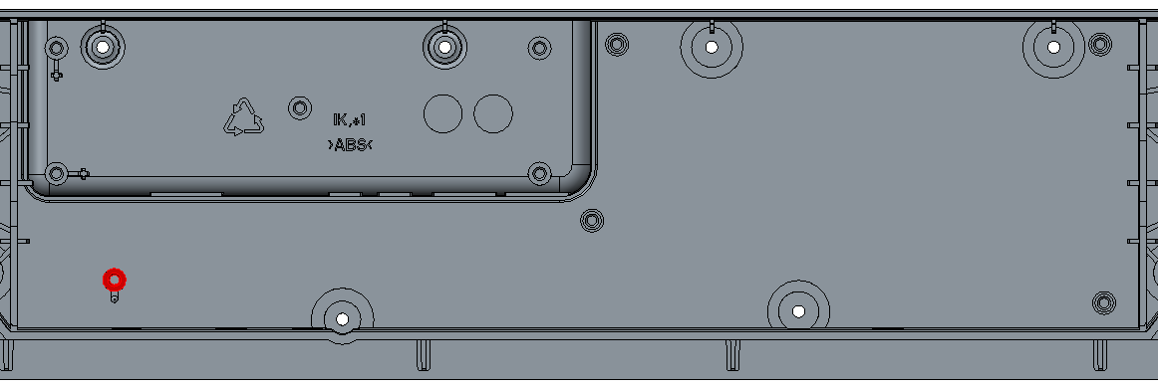
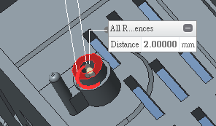
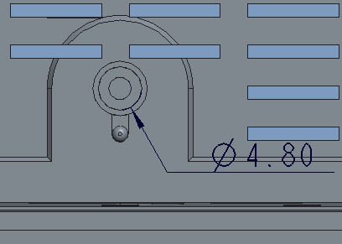
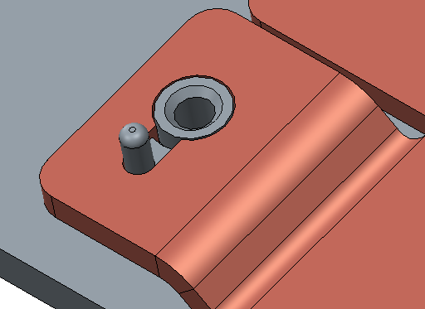
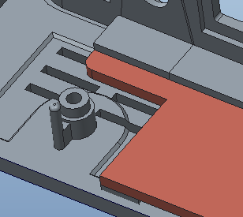
Heat spreader for DVT3 build
Need to be addedd by 2mm on screw hole
Heat spreader for DVT1 & 2 build
Please add 2mm on screw hole, so that we can also assembly the SoC board with DVT1 heat spreader samples.

